Slide 1
Create Your High Converting
Signature Talk
Notes:
Look for customers who are already looking for you

Slide 2
Signature Talk Outline
Why You Should Watch
What You Will Learn
Seed Your Offer
Your Hero’s Journey Story
Customer Success Story
Your Unique Step-by-Step process/solution/formula
High Value Lesson
Part 1, 2, & 3
Notes:
Where to get awesome free images:
Little Visuals
Unsplash
New Old Stock
Picjumbo
Gratisography
Getrefe
Jay Mantri
Picography
Startup Stock Photos
Life of Pix
Pexels
Superfamous

Slide 3
Signature Talk Outline
Your Unique Solution or Amazing Formula
Customer Success Story
Give Free Gift (if you are trying to collect e-mail/contact info)
High Value Exercise
Transition to offer 1 on 1 Strategy Session (to see if they fit/qualify for your Premium offer)
Customer Success Story
Heartfelt Thank You & Inspirational Close
Notes:
Where to get awesome free images:
Little Visuals
Unsplash
New Old Stock
Picjumbo
Gratisography
Getrefe
Jay Mantri
Picography
Startup Stock Photos
Life of Pix
Pexels
Superfamous

Slide 4
Notes:
Where to get awesome free images:
Little Visuals
Unsplash
New Old Stock
Picjumbo
Gratisography
Getrefe
Jay Mantri
Picography
Startup Stock Photos
Life of Pix
Pexels
Superfamous

Slide 5
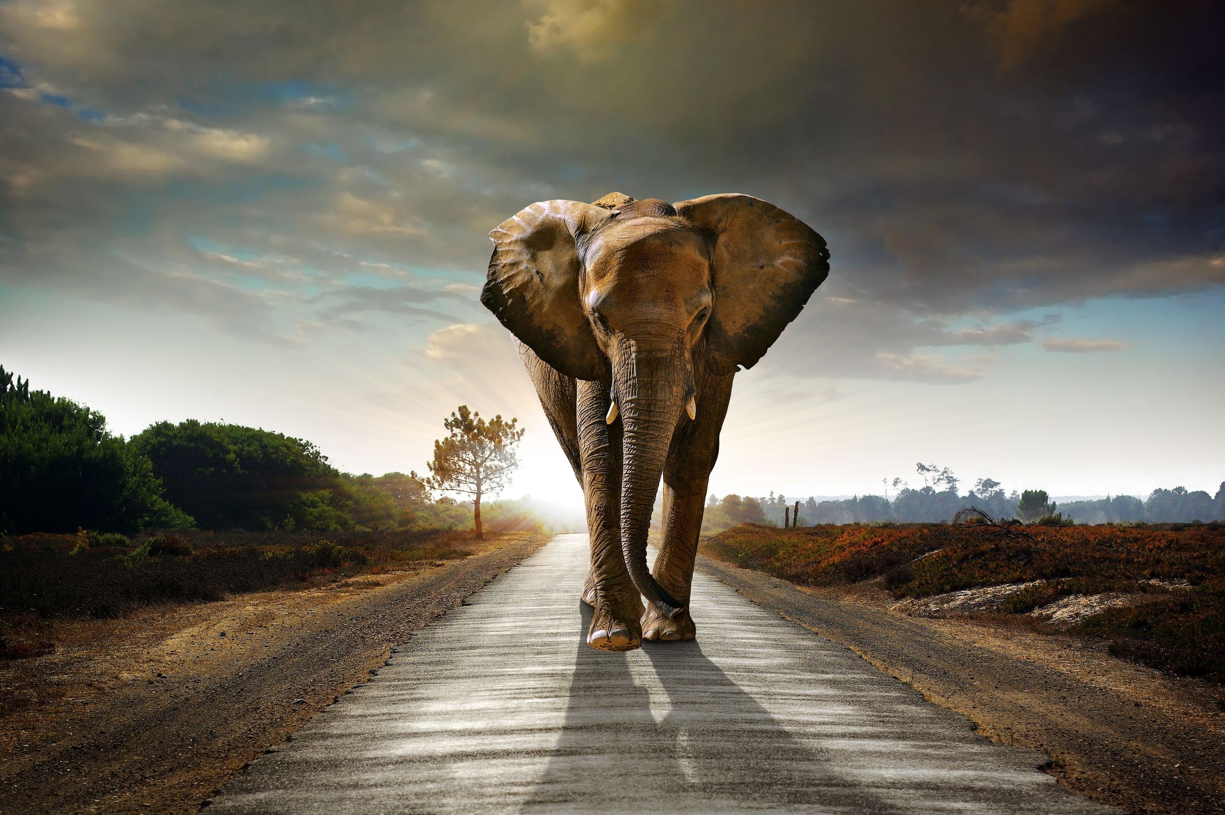
Signature Talk Title
With Big Bold Promise
Notes:
Where to get awesome free images:
Little Visuals
Unsplash
New Old Stock
Picjumbo
Gratisography
Getrefe
Jay Mantri
Picography
Startup Stock Photos
Life of Pix
Pexels
Superfamous

Slide 6
Why You Should Watch

Slide 7
Benefit #1
Notes:
10 Profitable Mindsets
of Top Facebook Marketers

Slide 8
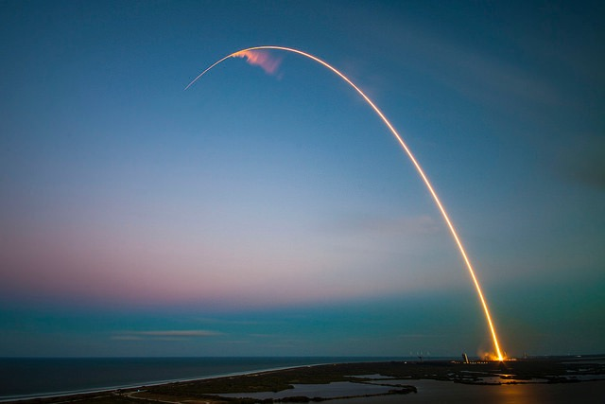
Benefit #2
Notes:
10 Profitable Mindsets
of Top Facebook Marketers

Slide 9
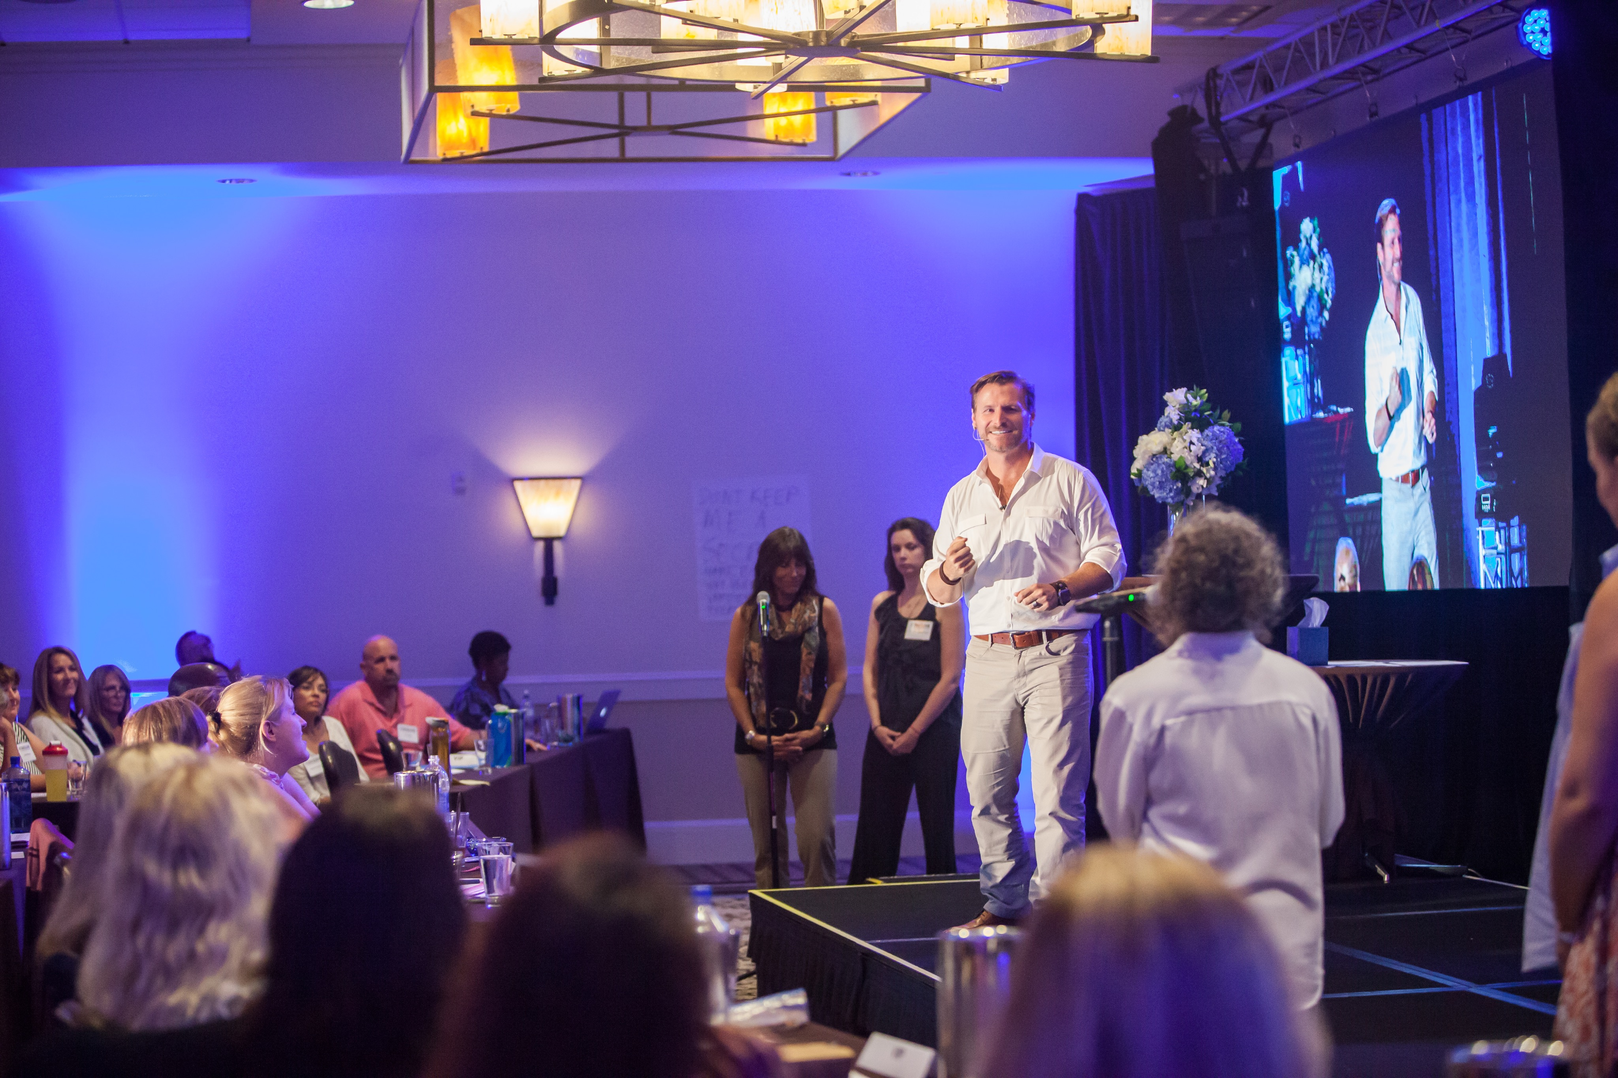
Seed Offer
Notes:
You will have to talk with customers every day to really understand the needs of your customers

Slide 10
What You Will Learn

Slide 11
Your Hero’s Journey Story Outline
Ordinary World
Call To Adventure
Major Challenge
Confront Biggest Fear
The Reward
Return With The Elixir (Formula/solution)
Paint Customers’ New Future
Notes:
Where to get awesome free images:
Little Visuals
Unsplash
New Old Stock
Picjumbo
Gratisography
Getrefe
Jay Mantri
Picography
Startup Stock Photos
Life of Pix
Pexels
Superfamous

Slide 12
(Your) Hero’s Journey
Notes:
What it takes to make your ads profitable
The Mindset Secrets of the most successful Facebook advertisers
What you have to do and the biggest mistakes to avoid

Slide 13
Ordinary World
Notes:
What it takes to make your ads profitable
The Mindset Secrets of the most successful Facebook advertisers
What you have to do and the biggest mistakes to avoid

Slide 14
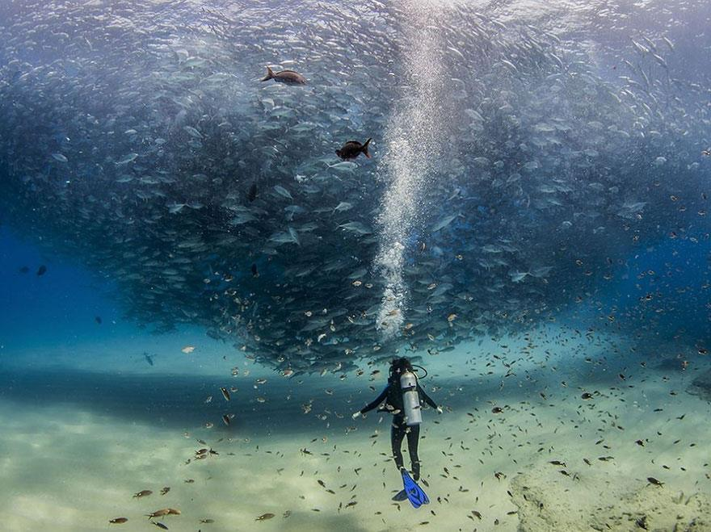
Call To Adventure
Notes:
What it takes to make your ads profitable
The Mindset Secrets of the most successful Facebook advertisers
What you have to do and the biggest mistakes to avoid

Slide 15
Major Challenge
Notes:
What it takes to make your ads profitable
The Mindset Secrets of the most successful Facebook advertisers
What you have to do and the biggest mistakes to avoid

Slide 16
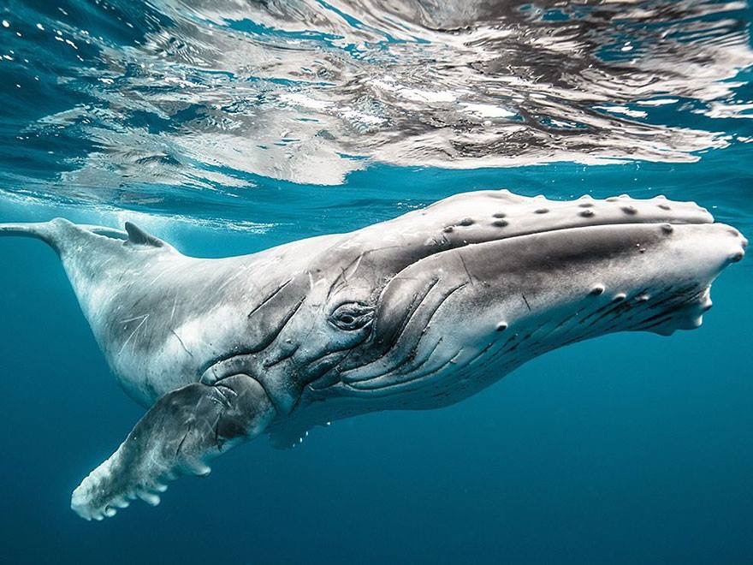
Confront Biggest Fear
Notes:
What it takes to make your ads profitable
The Mindset Secrets of the most successful Facebook advertisers
What you have to do and the biggest mistakes to avoid

Slide 17
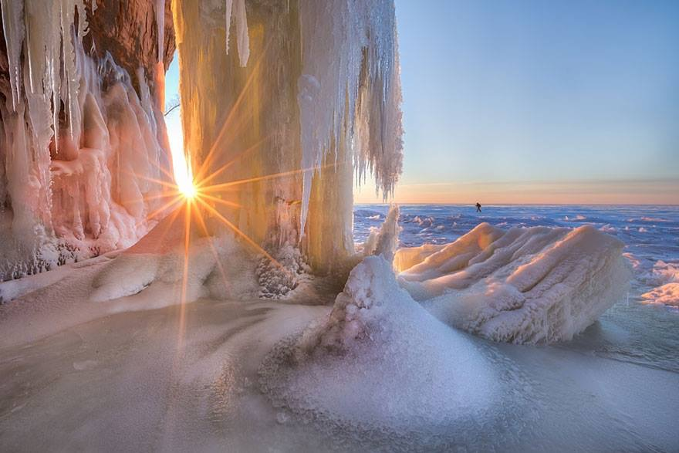
The Reward
Notes:
What it takes to make your ads profitable
The Mindset Secrets of the most successful Facebook advertisers
What you have to do and the biggest mistakes to avoid

Slide 18
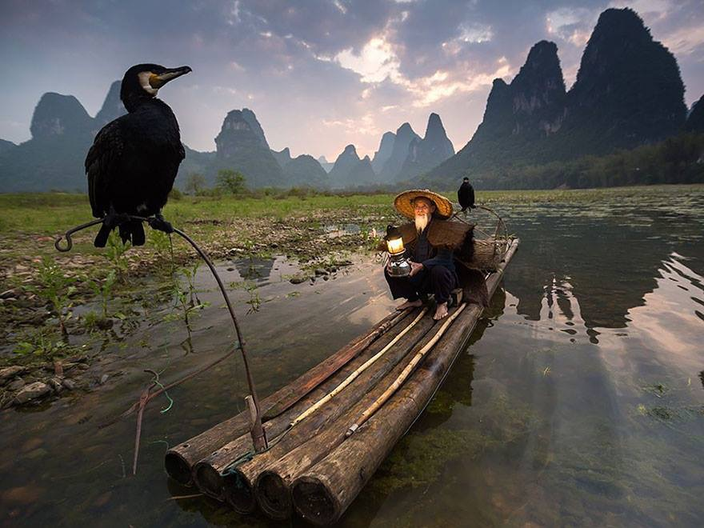
Return With Elixir
Notes:
return with elixir

Slide 19
Customer’s New Future
Notes:
What it takes to make your ads profitable
The Mindset Secrets of the most successful Facebook advertisers
What you have to do and the biggest mistakes to avoid

Slide 20
Customer Success Story
Notes:
Facebook is the world’s largest word of mouth marketing platform and should be used that way

Slide 21
Step-by-Step Process
Notes:
What it takes to make your ads profitable
The Mindset Secrets of the most successful Facebook advertisers
What you have to do and the biggest mistakes to avoid

Slide 22
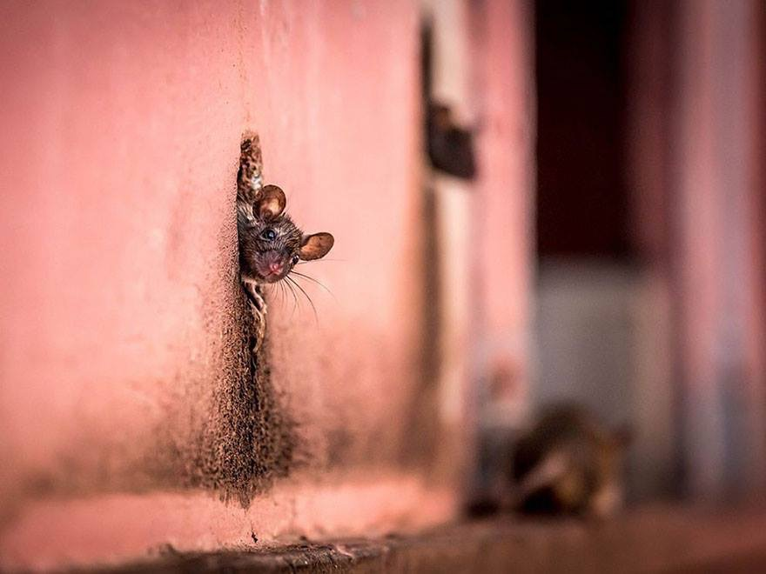
High Value Lesson Point1
Notes:
What it takes to make your ads profitable
The Mindset Secrets of the most successful Facebook advertisers
What you have to do and the biggest mistakes to avoid

Slide 23
How To:
Notes:
Facebook Post: https://www.facebook.com/LikeBret/posts/973427412711852
Highest Converting Lead Magnets Chart https://attractcustomersnow.com/bestleadmagnet/

Slide 24
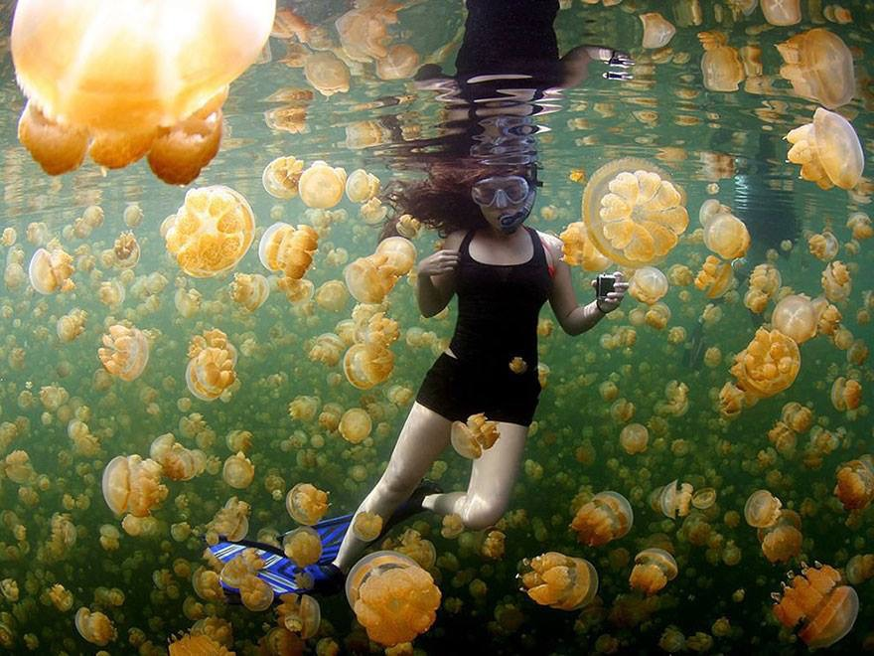
High Value Lesson Point 2
Notes:
Facebook Post: https://www.facebook.com/LikeBret/posts/973427412711852
Highest Converting Lead Magnets Chart https://attractcustomersnow.com/bestleadmagnet/

Slide 25
High Value Lesson Point 3
Notes:
Facebook Post: https://www.facebook.com/LikeBret/posts/973427412711852
Highest Converting Lead Magnets Chart https://attractcustomersnow.com/bestleadmagnet/

Slide 26
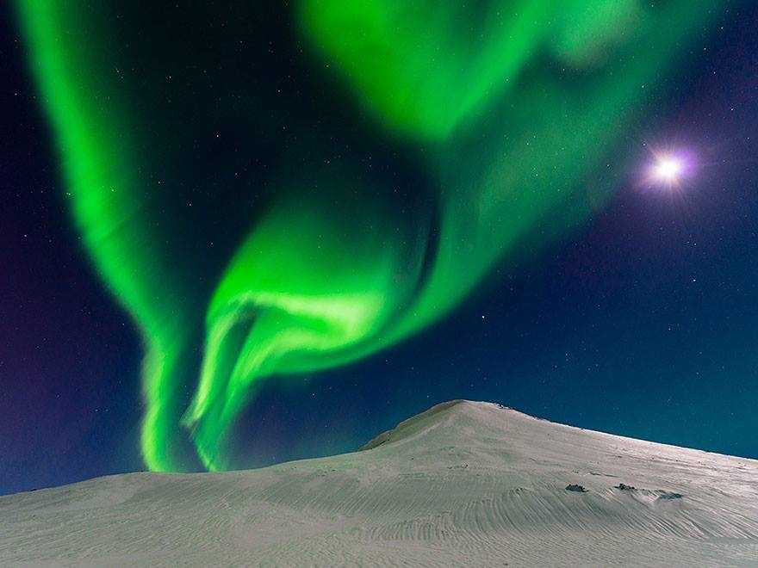
Amazing Formula

Slide 27
Customer Success Story
Notes:
Facebook is the world’s largest word of mouth marketing platform and should be used that way

Slide 28
Give Free Gift
Notes:
Facebook is the world’s largest word of mouth marketing platform and should be used that way

Slide 29
Customer Success Story
Notes:
Facebook is the world’s largest word of mouth marketing platform and should be used that way

Slide 30
Transition to Offer
Notes:
Look for customers who are already looking for you

Slide 31
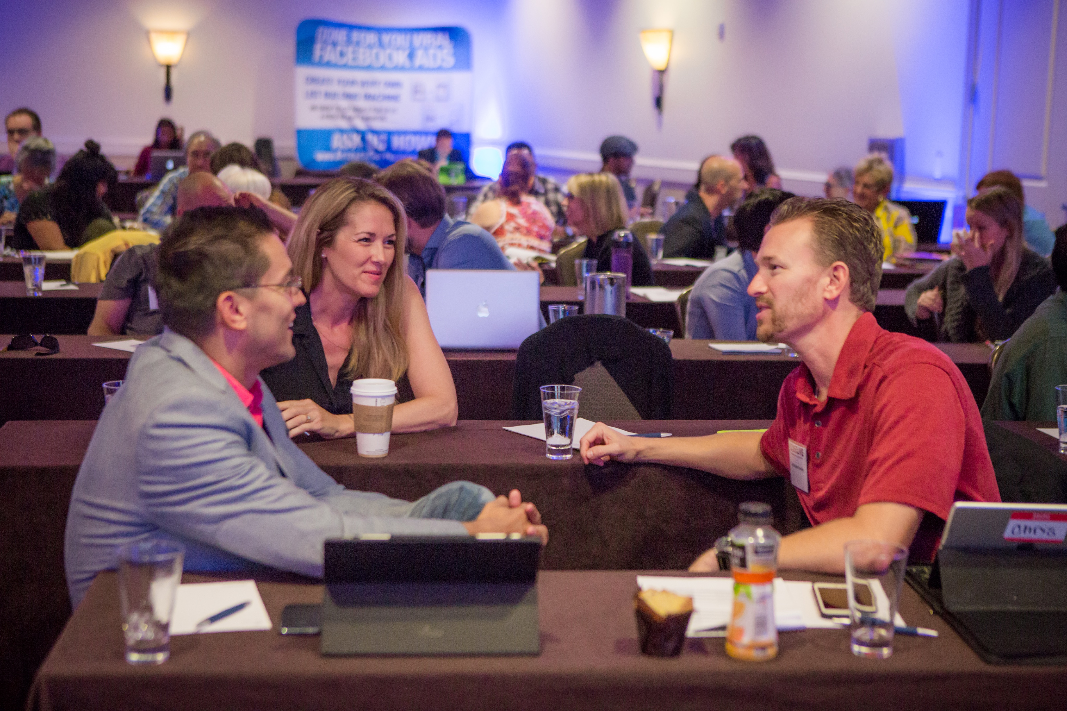
Must Create Value
Notes:
The success of your ads & marketing is directly proportional to the perceived value you create for your customers
Sign up for my newsletter - no perceived value
Sign up for my free webinar - also no perceived value
Create stunning viral Facebook ads in minutes with your free template click here to download now. - if thats targeted to the right audience it can work GREAT!

Slide 32
Motivating Customers
Notes:
Marketing is about motivating your customers to take action
“Sign up for my newsletter’ isn’t motivating because it doesn’t tell the customer what value they will get

Slide 33
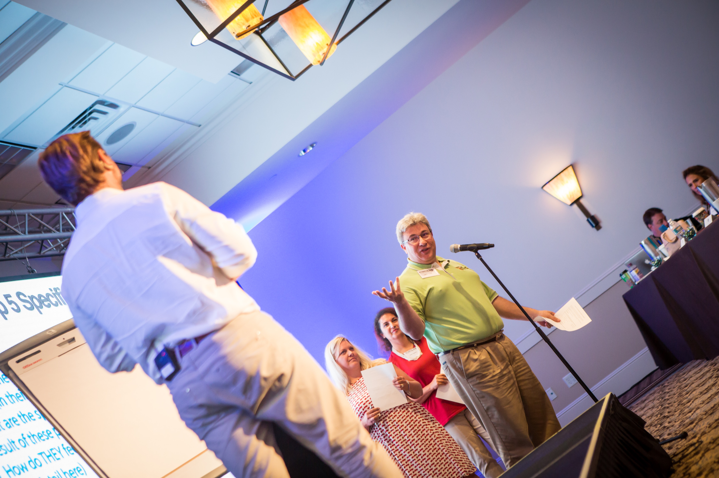
1 on 1 With You
Notes:
Look for customers who are already looking for you

Slide 34
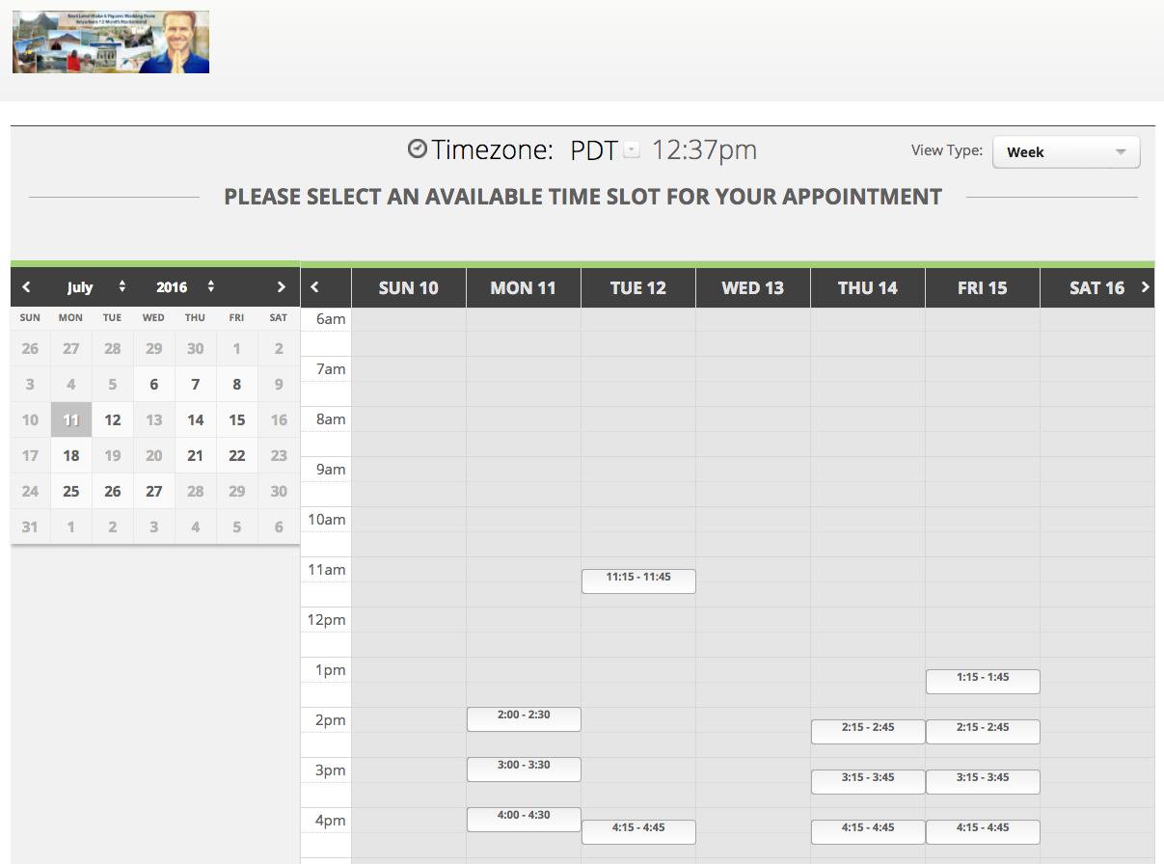
Book One on One
Notes:
Look for customers who are already looking for you

Slide 35
Heartfelt Thank You
Notes:
Making Great Ads Can Be Easy if you follow this formula.

Slide 36
Signature Talk Outline
Why You Should Watch
What You Will Learn
Seed Your Offer
Your Hero’s Journey Story
Customer Success Story
Your Unique Step-by-Step process/solution/formula
High Value Lesson
Part 1, 2, & 3
Your Unique Solution or Amazing Formula
Customer Success Story
Give Free Gift (if you are trying to collect e-mail/contact info)
High Value Exercise
Transition to offer 1 on 1 Strategy Session (to see if they fit/qualify for your Premium offer)
Customer Success Story
Heartfelt Thank You & Inspirational Close
Notes:
Where to get awesome free images:
Little Visuals
Unsplash
New Old Stock
Picjumbo
Gratisography
Getrefe
Jay Mantri
Picography
Startup Stock Photos
Life of Pix
Pexels
Superfamous

Slide 37
Where To Get
Awesome Free Images
123RF.com
flickr.com
pexels.com
pixabay.com
stocksnap.io
unsplash.com
newoldstock.com
Notes:
Where to get awesome free images:
Little Visuals
Unsplash
New Old Stock
Picjumbo
Gratisography
Getrefe
Jay Mantri
Picography
Startup Stock Photos
Life of Pix
Pexels
Superfamous

